Slide 1
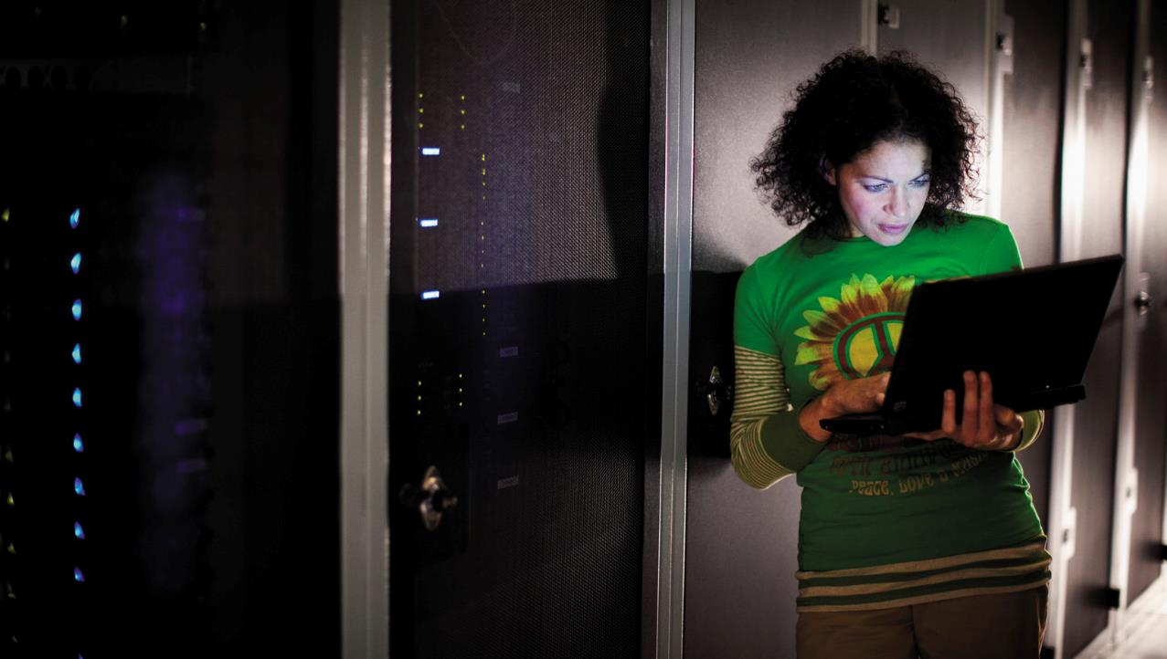
Welcome
Windows Azure Dev Camp

Slide 2

Wi-Fi
Please connect to the Wi-Fi network MSFTOPEN.
You will need to open a browser to connect.

Slide 3

Day's Schedule
Time | Activity / Session Title
8:15am – 9:00am | Guest arrival, Registration, Continental Breakfast, Guest setup
9:00am – 9:30am | Overview of the Microsoft Modern Platform
9:30am – 10:30am | A look at the Modern Principles
10:30am-10:45am | Break
10:45am – 12:45pm | Updating an application to a Modern Architecture, a hands-on lab with step-by-step instructions. Lunch – This is a working lunch. Lunch will be served, and guests can eat and work at their own pace.
12:45pm – 1:45pm | Introduction to Modern Dev/Test Practices
1:45pm – 2:00pm | Break
2:00pm – 4:00pm | Configuring and Testing a Modern Application, a hands-on lab with step-by-step instructions.
4:00pm – 4:30pm | Closing Remarks / Questions & Guest Departure
Notes:
Deck 0 should be shown during event setup, as people are coming in.
This schedule is a loose guideline. You should proactively monitor the attendees progress in labs. Set check points with them, and move forward if people are comfortable with what they have done, or are completed. Keep the day loose and flowing. It is possible for someone to finished lab 1 during lab 2’s time. At the end, as long as they have gotten some hands one time, and played with what interests them, then we have succeeded.

Slide 4

How to get started
Get free trial
aka.ms/AzureCampsTrial
Install VS2012
aka.ms/AzureCampsVS12
Install SDK
aka.ms/SDK
Download lab materials
aka.ms/TLabs

Slide 5

Labs
Most of the day will be with Hands on Labs. All of the materials are provided for you.
If you need help with setup, please ask a proctor.

Slide 6

© 2013 Microsoft Corporation. All rights reserved. Microsoft, Windows, Windows Vista and other product names are or may be registered trademarks and/or trademarks in the U.S. and/or other countries.
The information herein is for informational purposes only and represents the current view of Microsoft Corporation as of the date of this presentation. Because Microsoft must respond to changing market conditions, it should not be interpreted to be a commitment on the part of Microsoft, and Microsoft cannot guarantee the accuracy of any information provided after the date of this presentation. MICROSOFT MAKES NO WARRANTIES, EXPRESS, IMPLIED OR STATUTORY, AS TO THE INFORMATION IN THIS PRESENTATION.

